Slide 1
AI Fitness Trainer: Squats Analysis
Presented To: Emanuel Panizzi
Presented By: Azmeera Qureshi
+ Ismail Hossain Sohan

Slide 2
AI Fitness Trainer: Squats Analysis
Introduction:
We aim to build an AI fitness trainer that can help to perform squats seamlessly, irrespective of whether you are a beginner or a pro. To achieve this task we have opted to use Mediapipe’s Pose pipeline for estimating the human keypoints.
The application will also have provisions to perform squats in Beginner and Pro modes, along with appropriate feedback.

Slide 3
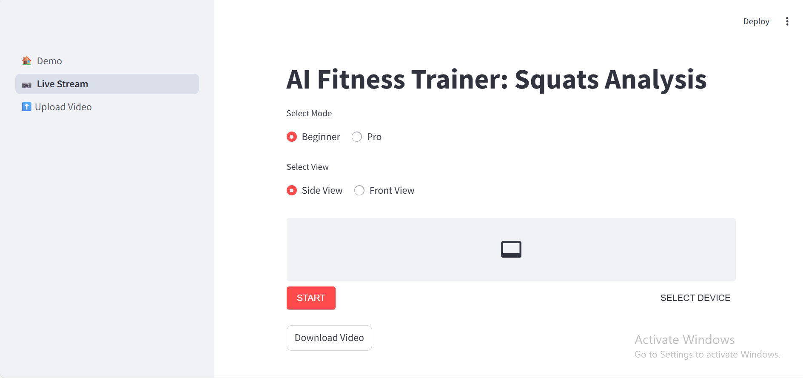

Slide 4
AI Fitness Trainer: Squats Analysis
MediaPipe Pose is an ML solution for high-fidelity body pose tracking, inferring 33 3D landmarks and background segmentation masks on the whole body from RGB video frames utilizing the BlazePose, which is a superset of COCO, BlazeFace, and BlazePalm topologies.
The pipeline for MediaPipe pose consists of a two-step detection-tracking pipeline similar to MediaPipe Hands and MediaPipe Face Mesh solutions. Using a detector, the pipeline first locates the person/pose region-of-interest (ROI) within the frame. The tracker subsequently predicts the pose landmarks and segmentation mask within the ROI using the ROI-cropped frame as input.

Slide 5

Fig: BlazePose Landmarks

Slide 6
Intuition of Frontal and Side View for Posture Analysis
While designing an application to analyze various fitness exercises, one might be curious to perform various calculations keeping in mind the view of the object (person) from the camera.
We have added the frontal view option as well as side view. A person can try one view at one time.
Using the frontal view, we have access to both left and right sides and hence can leverage the use of slopes and angles of the various landmark points, such as the angle between the knee-hip and knee-knee lines, etc.

Slide 7
Intuition of Frontal and Side View for Posture Analysis
We can use the side view to find better estimates of various inclinations concerning the verticals or horizontals. Such information can be beneficial for analyzing exercises such as deadlifts, pushups, squats, dips, etc.
Since we are analyzing squats and all significant computations concerning the appropriate inclinations with the verticals, we have opted for a side view.

Slide 8
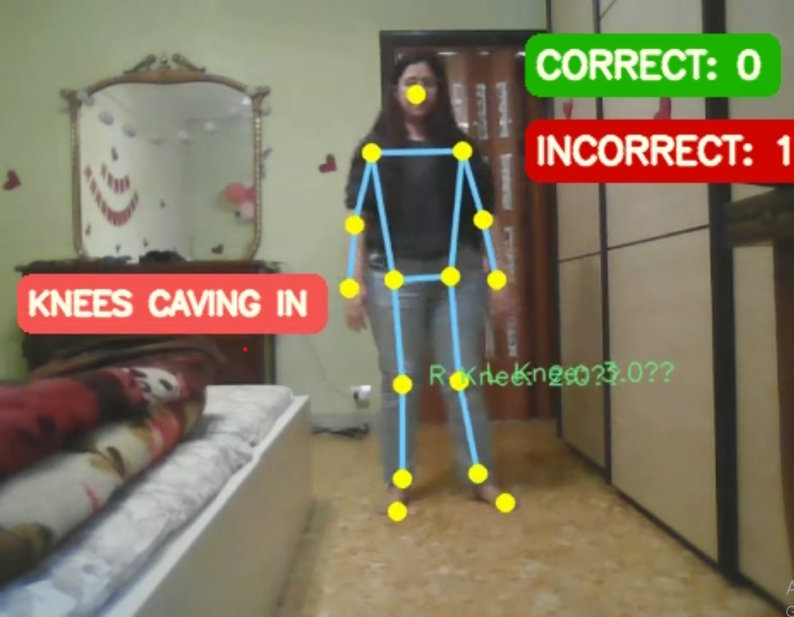
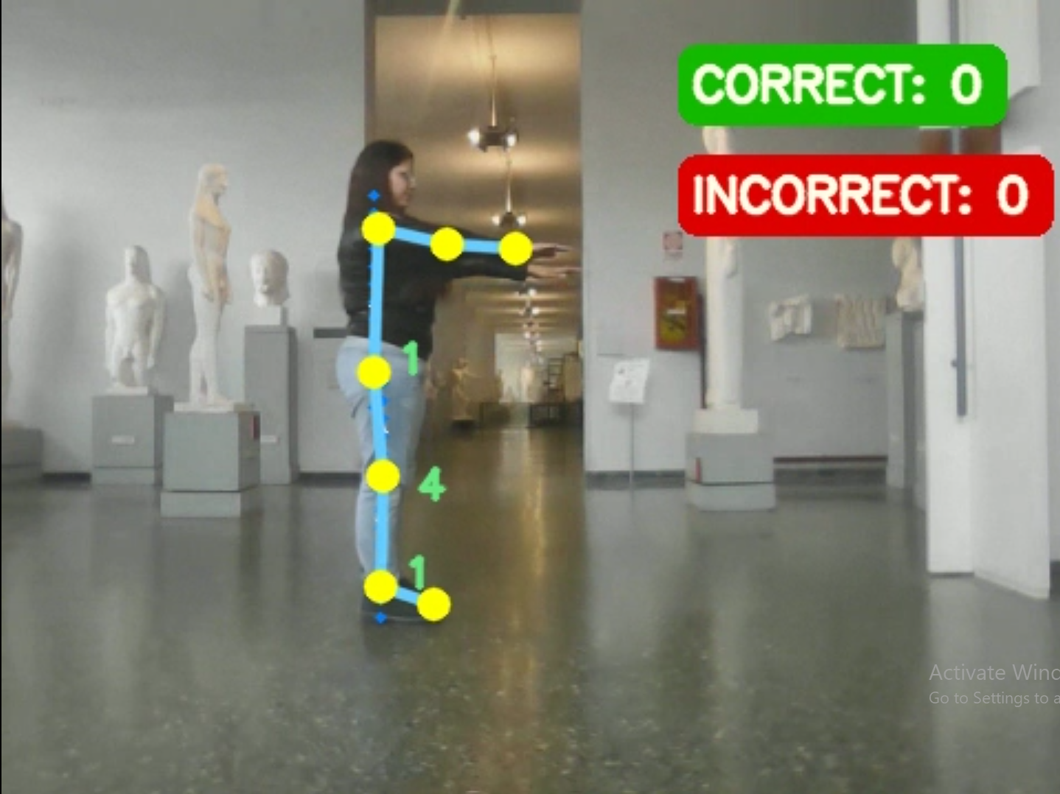
Front View
Side View

Slide 9
AI Fitness Trainer: Squats Analysis
(side view)

Slide 10
AI Fitness Trainer: Squats Analysis (side view)
We will consider the angles of the hip-knee, knee-ankle, and shoulder-hip lines with the verticals to calculate the states (explained in the subsequent sections) and perform the appropriate feedback messages. This is depicted in the image below.
Additionally, we shall calculate the offset angle (the angle subtended by the nose and the shoulders) with a proper warning to maintain a good side view.
Besides, we will also consider the timings for computing inactivity subject to which the counters for proper and improper squats would be reset.
The application will also provide two modes: Beginner and Pro; one can choose either of them and start performing squats seamlessly, irrespective of whether he is a beginner or an expert.

Slide 11
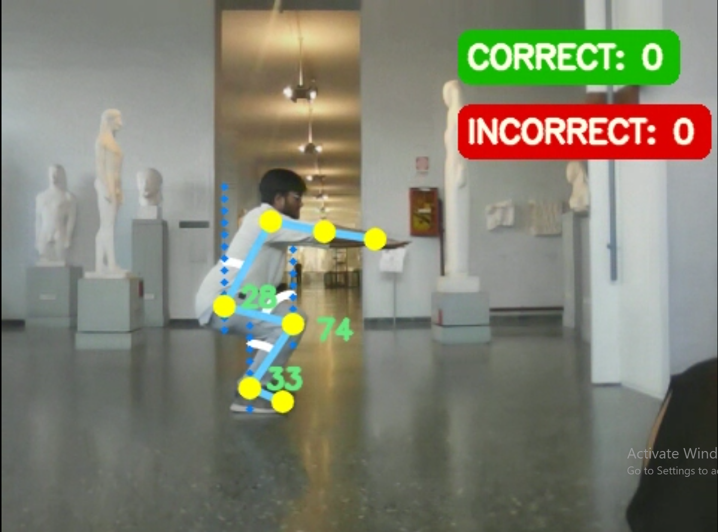
AI Fitness Trainer: Squats Analysis (side view)
Shoulder
Knee
Hip

Slide 12
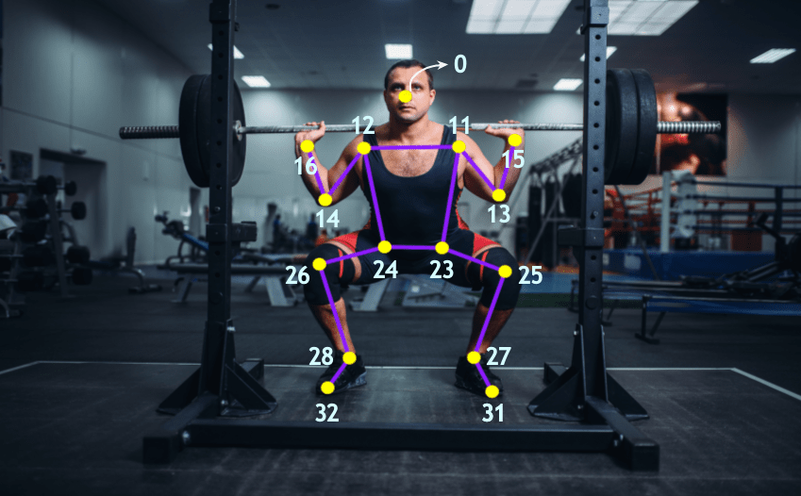
Core Functionalities Added
A. Skeleton Detection & Visualization
What it does: Draws a complete body skeleton using 33 pose landmarks
Logic:
Uses MediaPipe's pose detection (11-32 landmarks + nose)
Connects key joints (shoulders, hips, knees, ankles) with colored lines
Only draws visible landmarks (visibility score > 0.1)

Slide 13
B. Camera Alignment Check
What it does: Ensures proper Side-view positioning
Logic:
Calculates angle between shoulders and nose (offset_angle)
Checks if all key landmarks are visible
Threshold: OFFSET_THRESH = 35° (configurable)

Slide 14
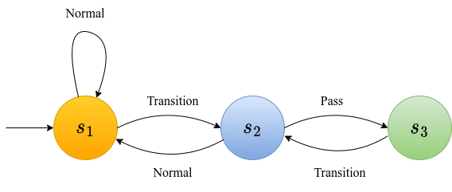
C. Squat State Machine
States:
s1 (Standing): If the angle between the knee and the vertical falls within 32°, then it is in the Normal phase, and its state is s1. It is essentially the state where the counters for proper and improper squats are updated.
s2 (Mid-Squat): If the angle between the knee and the vertical falls between 35° and 65°, it is in the Transition phase and subsequently goes to state s2.
s3 (Deep Squat If the angle between the knee and the vertical lies within a specific range (say, between 75° and 95°), it is in the Pass phase and subsequently goes to state s3
Valid Rep: s1 → s2 → s3 → s2 → s1
Early Termination: s1 → s2 → s1 (counts as error)

Slide 15
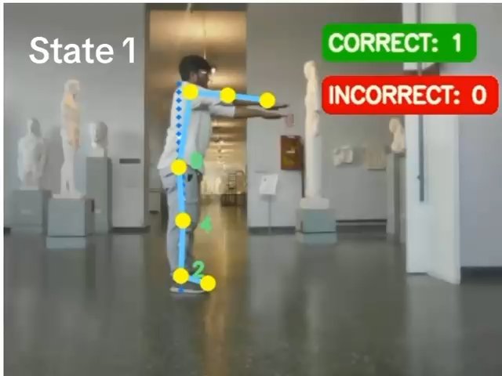
AI Fitness Trainer: Squats Analysis (side view)

Slide 16
We can finally provide the state transition diagram as well.
All calculations related to feedback are computed for states s2 and s3.
During our implementation, we maintain a list: state_sequence. It contains the series of states as the person goes from states s1 through s3 and back to s1. The maximum number of states in state_sequence is 3 ([s2, s3, s2]). This list determines whether a correct or an incorrect squat is performed.
Once we encounter state s1, we re-initialize state_sequence to an empty list for subsequent squat counts.

Slide 17
D. Form Error Detection
Error Type | Detection Logic | Threshold (Beginner)
Bend Forward | Hip vertical angle < 20° | 15
Bend Backward | Hip vertical angle > 45° | 50
Lower One’s Hip | knee vertical angle in between 50° and 80° | [50, 80]
Squat Too Deep | Knee vertical angle > 95° | 95
Knees Falling Over Toe | Ankle vertical angle > 95° | 0.30

Slide 18
E. Rep Counting System and Inactivity Handling
Correct Rep:
Completes full state sequence [s2, s3, s2]
No form errors detected
Returns to s1 (standing)
Incorrect Rep:
Any form error during movement
Incomplete state sequence
Inactivity Handling
Resets counters after 15s (INACTIVE_THRESH) of:
No poses detected OR
No state changes (static pose)
Offset angle> offset threshold (facing directly towards camera and when camera is not aligned properly)

Slide 19
F. Visual Feedback Pipeline
Frame Processing:
Detect pose → Draw skeleton → Check alignment
Form Analysis:
Calculate distances/angles → Detect errors → Update states
Feedback Generation:
Show counters → Display errors → Handle inactivity

Slide 20
G. Real-Time Performance:
Processes ~30 FPS on modest hardware
Minimal lag between actual movement and feedback

Slide 21
Application Workflow and Thresholds
We first declare the following thresholds along with the two counters:
STATE_THRESH: A set of thresholds that determine the state that each frame belongs to.
FEEDBACK_THRESH: A set of thresholds to determine the feedback information that needs to be displayed.
OFFSET_THRESH: Threshold to determine if the person is facing directly toward the camera.
INACTIVE_THRESH: Threshold to determine inactivity, failing which the counters: CORRECT and INCORRECT are reset.
Counters: CORRECT and INCORRECT to count the number of proper and improper squats, respectively.

Slide 22
2. We read each frame from the webcam/video, pre-process it and pass it through MediaPipe’s Pose solution
3. We then retrieve the desired landmarks for the Shoulders, Nose, Knee, Hip, and Ankle, provided the detection landmarks are available; else, we move on to compute INACTIVE TIME (in secs) when there are no detections.
If this INACTIVE TIME passes the INACTIVE_THRESH, we reset the counters: CORRECT and INCORRECT.
4. The offset angle (discussed in the later section) is calculated for the Nose and Shoulder coordinates.
If the offset angle overshoots the OFFSET_THRESH, we display the appropriate warning and compute the INACTIVE TIME as discussed in Step 3

Slide 23
5. When the offset angle is within the OFFSET_THRESH, we go on to calculate the following:
The angles shoulder-hip, hip-knee, and knee-ankle lines with the verticals.
The current_state of the frame is calculated based on STATE_THRESH.
A list: state_sequence is maintained (discussed in the previous section).
6. When the current state is encountered as s1, we update the counters: CORRECT and INCORRECT based on the contents of state_sequence. Otherwise, we compute and display the feedback messages based on FEEDBACK_THRESH and compute the INACTIVE TIME.
7. We assign prev_state with current_state and proceed to fetch the subsequent frames.

Slide 24
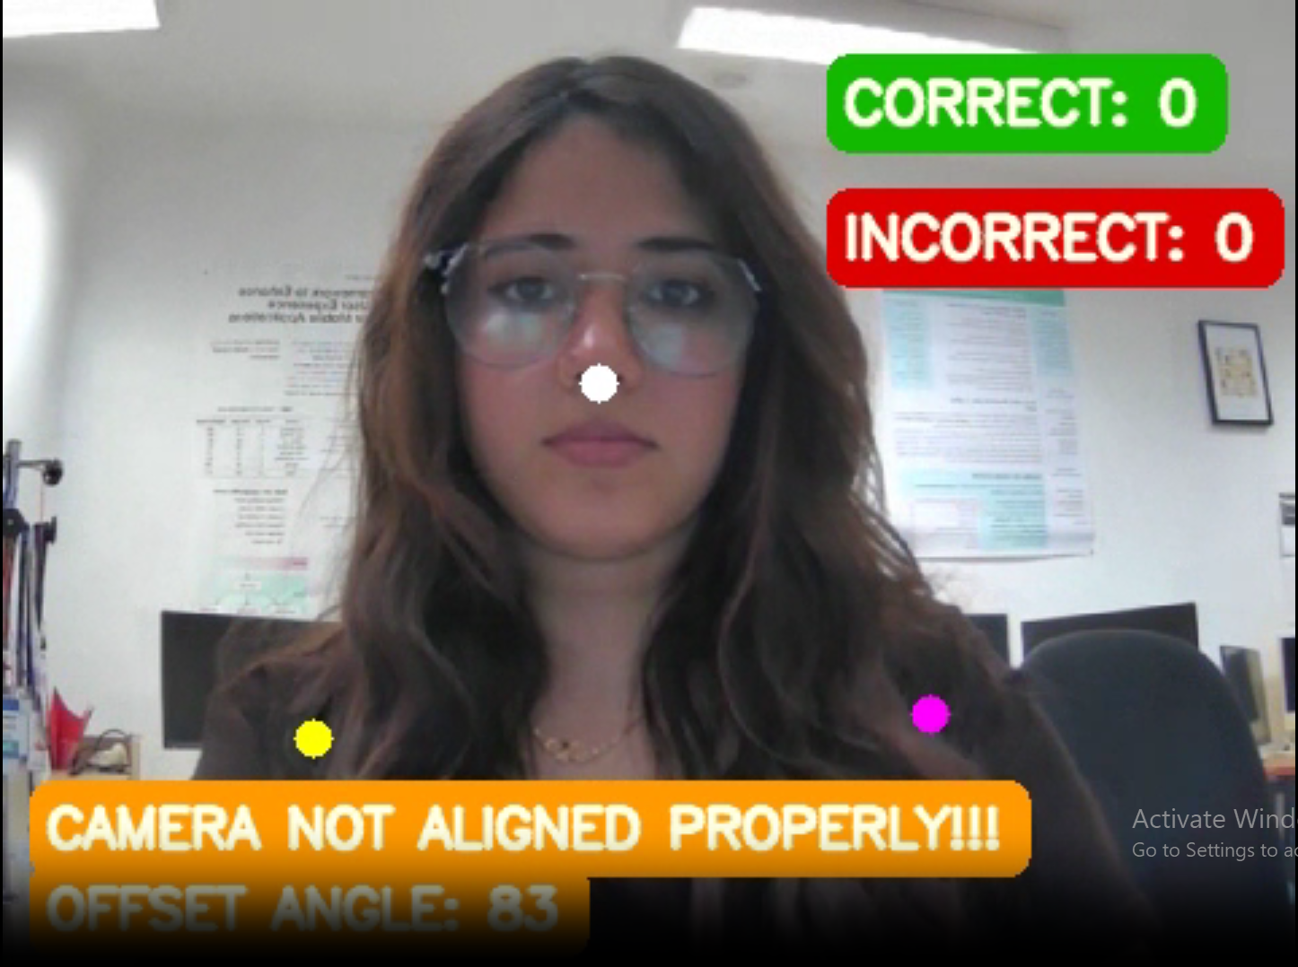
For instance, to calculate the offset angle, we shall find the angle between the nose and the shoulders, with the coordinates of the nose being the reference point.
Nose
Right Shoulder​
Left Shoulder​

Slide 25
Feedback Actions
Our application shall provide five feedback messages while one performs a squat, namely:
Bend Forward
Bend Backwards
Lower one’s hips
Knee falling over toes
Deep squats

Slide 26
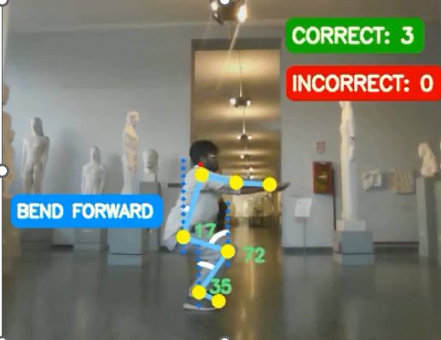
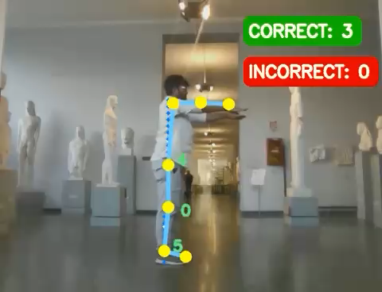
Feedback 1 "Bend Forward" is displayed when the hip-vertical angle (i.e., the angle between the shoulder-hip line with the vertical) falls below a threshold, for instance, 20°, as shown in the following figure.

Slide 27
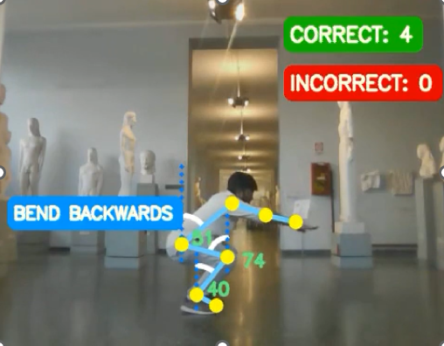
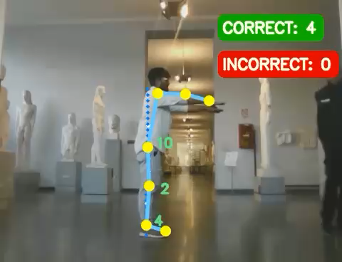
Feedback 2 “Bend Backwards” is displayed when the hip-vertical angle falls above a threshold, for instance, 45°, as shown below.

Slide 28
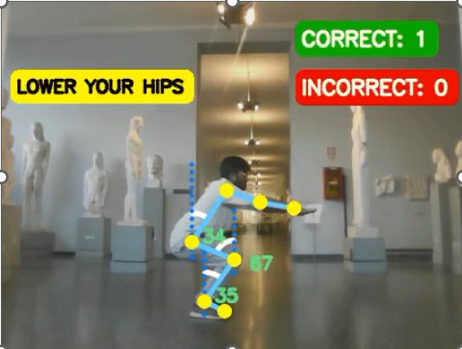
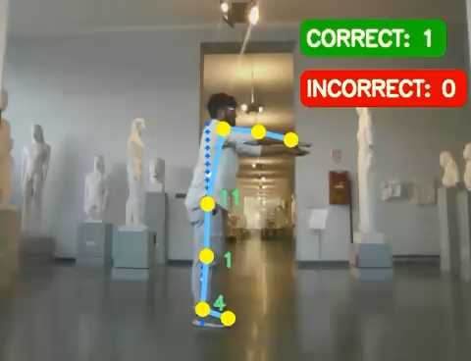
Feedback 3 "Lower one’s hips" is responsible when the angle between the hip-knee line with the vertical is within thresholds, say between 50° and 80°, as shown below.

Slide 29
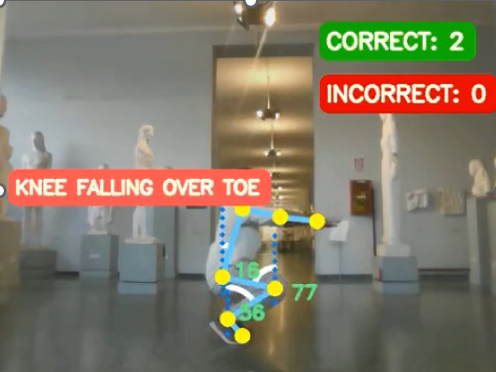

Feedback 4 “Knee falling over toes” is displayed when the angle between the knee-ankle line with the vertical lies above a threshold, for instance, 30°, as shown.

Slide 30
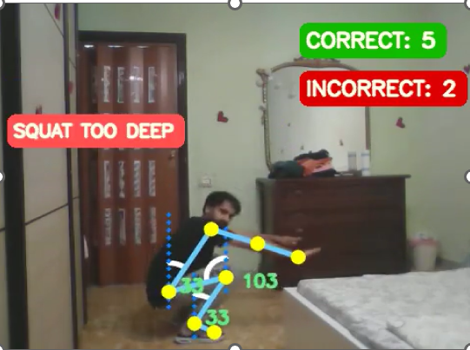
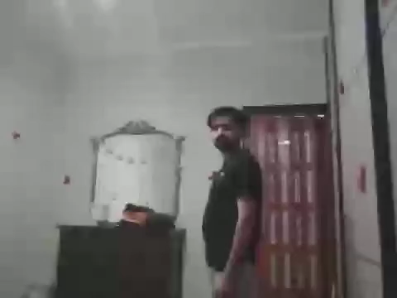
Feedback 5 "Deep squats" is displayed when the angle between the hip-knee line with the vertical; transitions through state s3 and goes beyond a threshold, for instance, 95°.

Slide 31
Computing Inactive Times
As mentioned earlier, another aspect of our application is to reset all counters (for correct and incorrect squats) owing to inactivity. Inactivity is computed when an object (person) maintains a certain state beyond some T time. The threshold T is measured in seconds. We have set the value of T to 15 seconds.
There are three situations when our application encounters inactivity:
We are facing directly toward the camera (i.e., offset angle > OFFSET_THRESH) beyond T seconds.
The state of the person remains unchanged beyond T seconds.
There are no detections beyond T seconds.

Slide 32
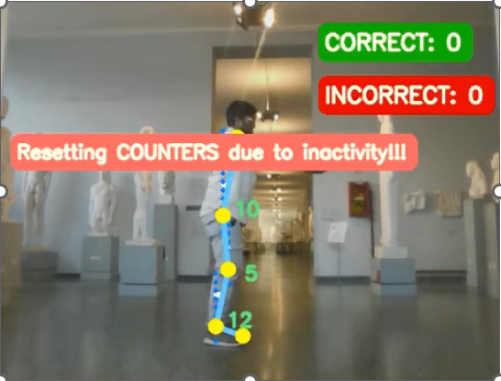
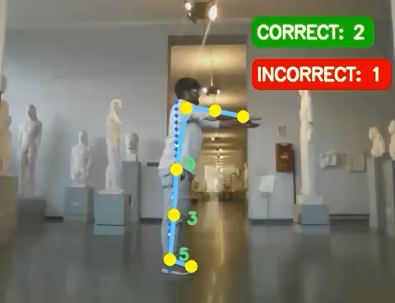
Computing Inactive Times

Slide 33
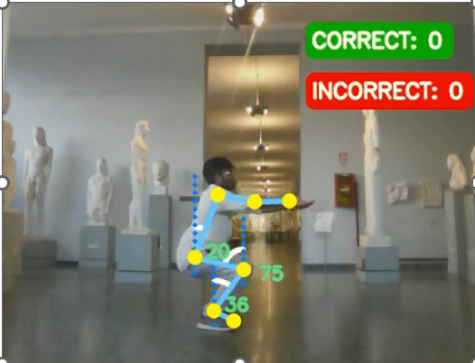

Correct Squats

Slide 34
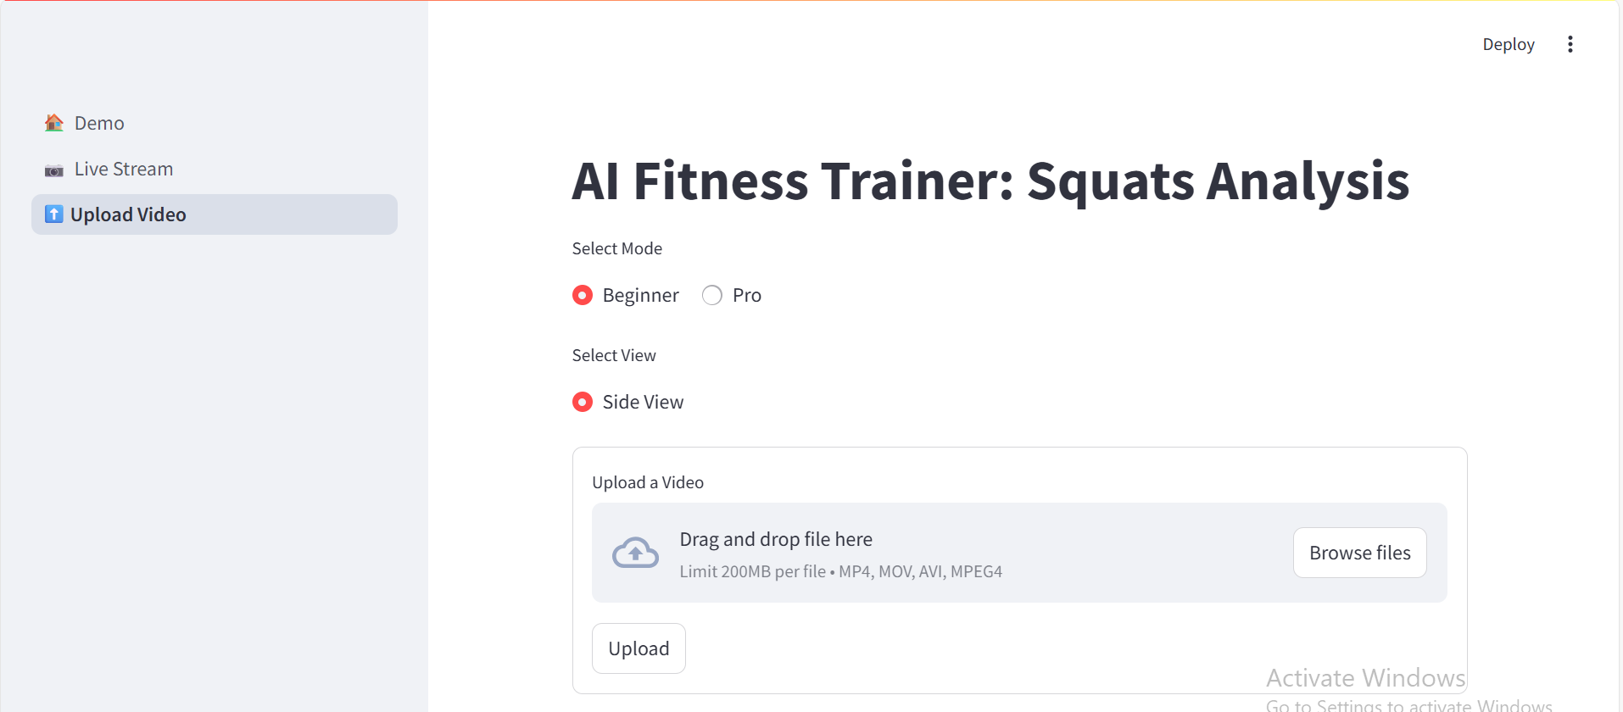
Upload Section
The Upload Section allows users to upload a pre-recorded workout video (such as squats) for pose analysis and feedback using AI-powered posture detection.

Slide 35
Key Points – Upload Section (AI Fitness Trainer)
📁 Upload Feature: Allows users to upload pre-recorded workout videos (.mp4, .mov, .avi) for posture analysis.
🧠 AI-Powered Pose Detection: Each video frame is analyzed using MediaPipe to detect human body keypoints.
🎯 Mode & View Selection: Users can choose "Beginner" or "Pro" mode and "Side View" (Front View can be added later).
📊 Posture Evaluation: Squat form is checked against predefined angle thresholds to detect errors or provide feedback.
🖼️ Frame-by-Frame Display: Each processed frame with visual feedback is shown live inside the app.
💾 AI-Processed Output: The processed video is saved with overlays indicating correctness of the exercise.
⬇️ Downloadable Feedback: Users can download the final video for personal review or coaching use.

Slide 36
AI Fitness Trainer: Squats Analysis
(Application Reviews)

Slide 37
Name and surname | Email | Occupation/ Role | How easy was it to use this application (1- very difficult –5 very easy) | How accurate did you find the posture detection and feedback (1-5) | Did you find any technical issue while using this tool? (yes/no/somewhat) | Was the real time feedback helpful in improving your squat form? (yes/no somewhat) | How would you rate the user interface and visual clarity? (Linear scale 1-5) | What did you like most about the interface ? | What additional feature would you like to see in the future?
Azmeera Qureshi | Azmeeraqureshi@gmail.com | Masters student | 5 | 5 | no | yes | 5 | Live streaming | More exercises should be added
Lorenzo | Antonelli@di.uniroma1.it | Masters student | 5 | 5 | no | yes | 5 | Real time feedback | Frontal view and also a sound feedback
Marco | realacci@di.uniroma.it | Masters student | 5 | 5 | no | yes | 5 | Real time feedback | Sound feedback
Ismail Hossain Sohan | Sohanh621@gmail.com | Masters Student | 5 | 5 | no | yes | 5 | Accuracy | Frontal view
Shrikant verma | Datla@di.uniroma1.it | Phd scholar | 5 | 5 | yes | yes | 4 | Live stream and the feedback system | Even bigger feedback or textual
palma | Palma.2043253@studenti.uniroma1 | Masters student | 5 | 4 | no | yes | 5 for live stream and for 4 for upload section | Simplicity of the interface like everything was clear | More bigger feadbacks in upload video section
damiano |  | Phd scholar | 5 | 5 | no | yes | 5 |  | Side along with front parellely
Aizaz | Aizazaliqureshii@gmail.com | System engineer | 5 | 5 | somewhat | yes | 4 | The accuracy of angles detection | Music should be added for motivation

